Slide 1
DevNet Learning Forum
1 – DevNet Intro, Environment Setup

Slide 2
Agenda
Week1
DevNet Introduction
Dev Environment Setup
Week2
Data Models
Python for Network
Week3
Yang, Netconf, Restconf
Network Device API
Week4
Guest Shell
Application Hosting
Week5
DevOps
Ansible
Repository
https://github.com/tqs0117/devnet_forum
Branch
gc_ent_ss

Slide 3
Agenda
About DevNet
Development Environment

Slide 4
About DevNet

Slide 5
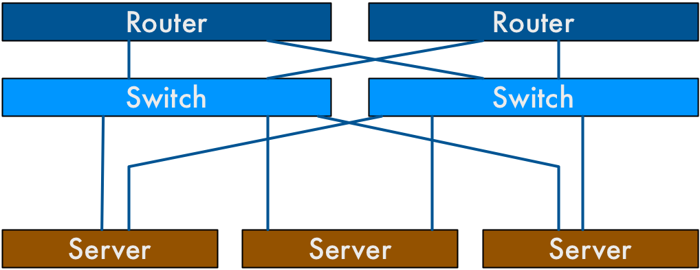
Yesterday’s Network

Slide 6
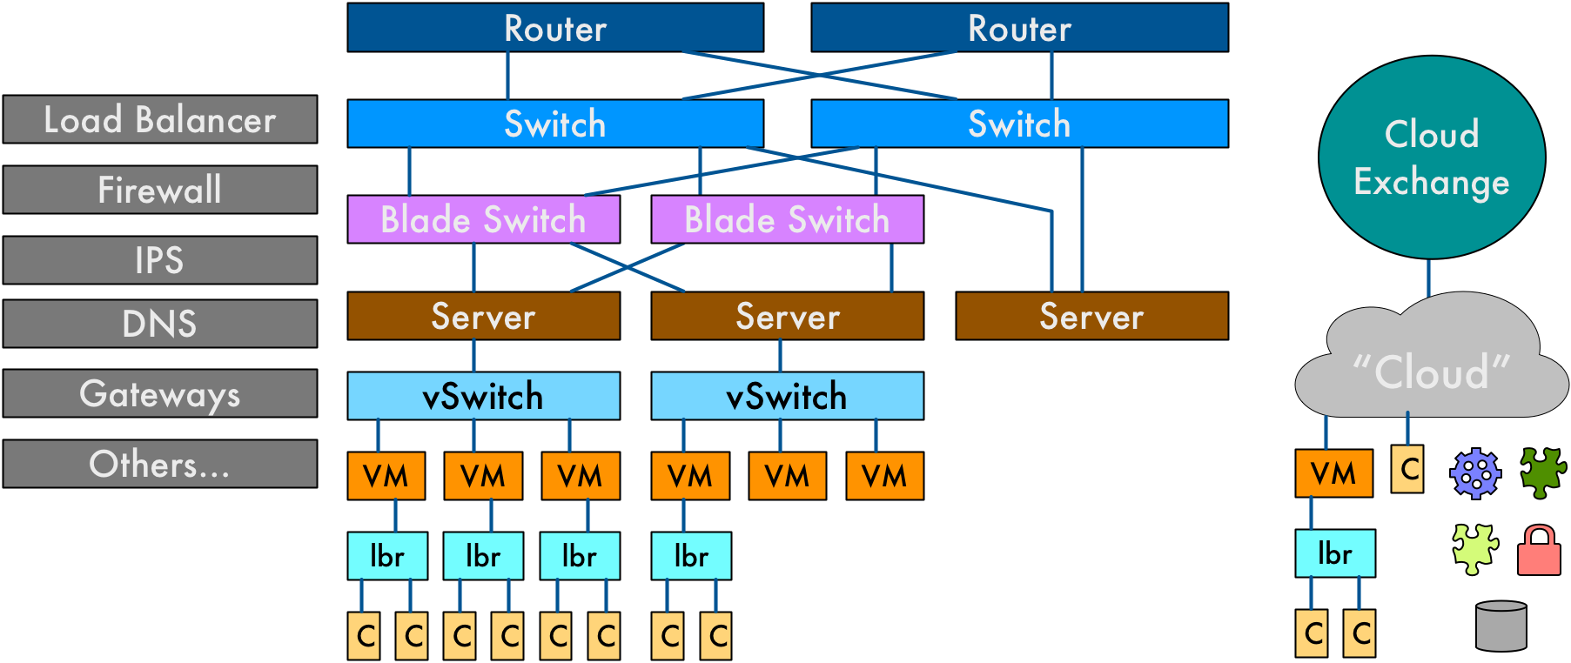
Today’s Network

Slide 7




Stone Age
Bronze Age
The Renaissance
Programmable Age
Spanning Tree
VLANs
Routing Protocols
WAN Design
IP-magedon
SDN
OpenFlow
Controllers
Overlays
MP-BGP
VXLAN
Micro-Segmentation
White Box
Cloud
Python
REST / APIs
NETCONF / YANG
“Fabrics”
Network Function Virtualization (NFV)
Containers
DevOps
NetDevOps!
The Four Ages of Networking…..

Slide 8

The NetDevOps Engineer
Network Skills
Layer 2 & 3 Fundamentals
Quality of Service
Security and Segmentation
Linux Networking
Container Networking
Cloud Networking
IOT Networking
Model Driven Programmability
Network Function Virtualization
Platform Skills
Linux Administration
Container Fundamentals
Micro Service Platforms
Cloud Fundamentals
Programming Skills
Data Formats (ex: JSON/YAML)
Python and APIs (ex: REST)
Source Control (ex: git)
Configuration Management (ex: Ansible)
Notes:
But that was yesterday’s Carl. Today Carl is a “NetDevOps Engineer” through and through.
Through a significant amount of study and hard work (and maybe a little help from his brother Captain Cloud), Carl has reinvigorated his career by fleshing out his skills portfolio.
First, he realized that “the network” has come a long way from when it was simply composed of routers and switches and servers. Today’s network includes virtual switches, Linux bridges, containers, clouds, micro service stacks, network services, and so much more. This mean that he needed to broaden his scope of topics.
He started by really exploring the world of programming fundamentals and learned about data formats, picked up Python, learned all about APIs, and signed up for a GitHub account.
He also realized that to be relevant today as a network engineer, he had to understand the new key platforms where applications were running. A bit nervous at first, he quickly realized it was kinda fun to play around with Linux, Docker, Kubernetes and “the cloud”.
All of his Layer 2 and 3, QoS, Security, and other core networking skills are still critical and he hasn’t’ forgotten any of them, but where he really had fun was when he noticed all the new networking skills he could learn. Exploring Linux networking concepts weren’t that hard, and container networking was kinda fun. And when he looked at the state of Cloud and IOT networking he was shocked at how much he had to offer his peers who had been building networks in these spaces while he had his head in the sand.
Yep, Carl has really fallen back in love with networking as a NetDevOps Engineer.

Slide 9
Learn
Code
Inspire
Connect
DevNet Learning Tracks & Certificate(new)
DevNet Sandbox & APIs
DevNet Creations & Code Exchange
DevNet Community & Events
Phase-1
Phase-2

Slide 10
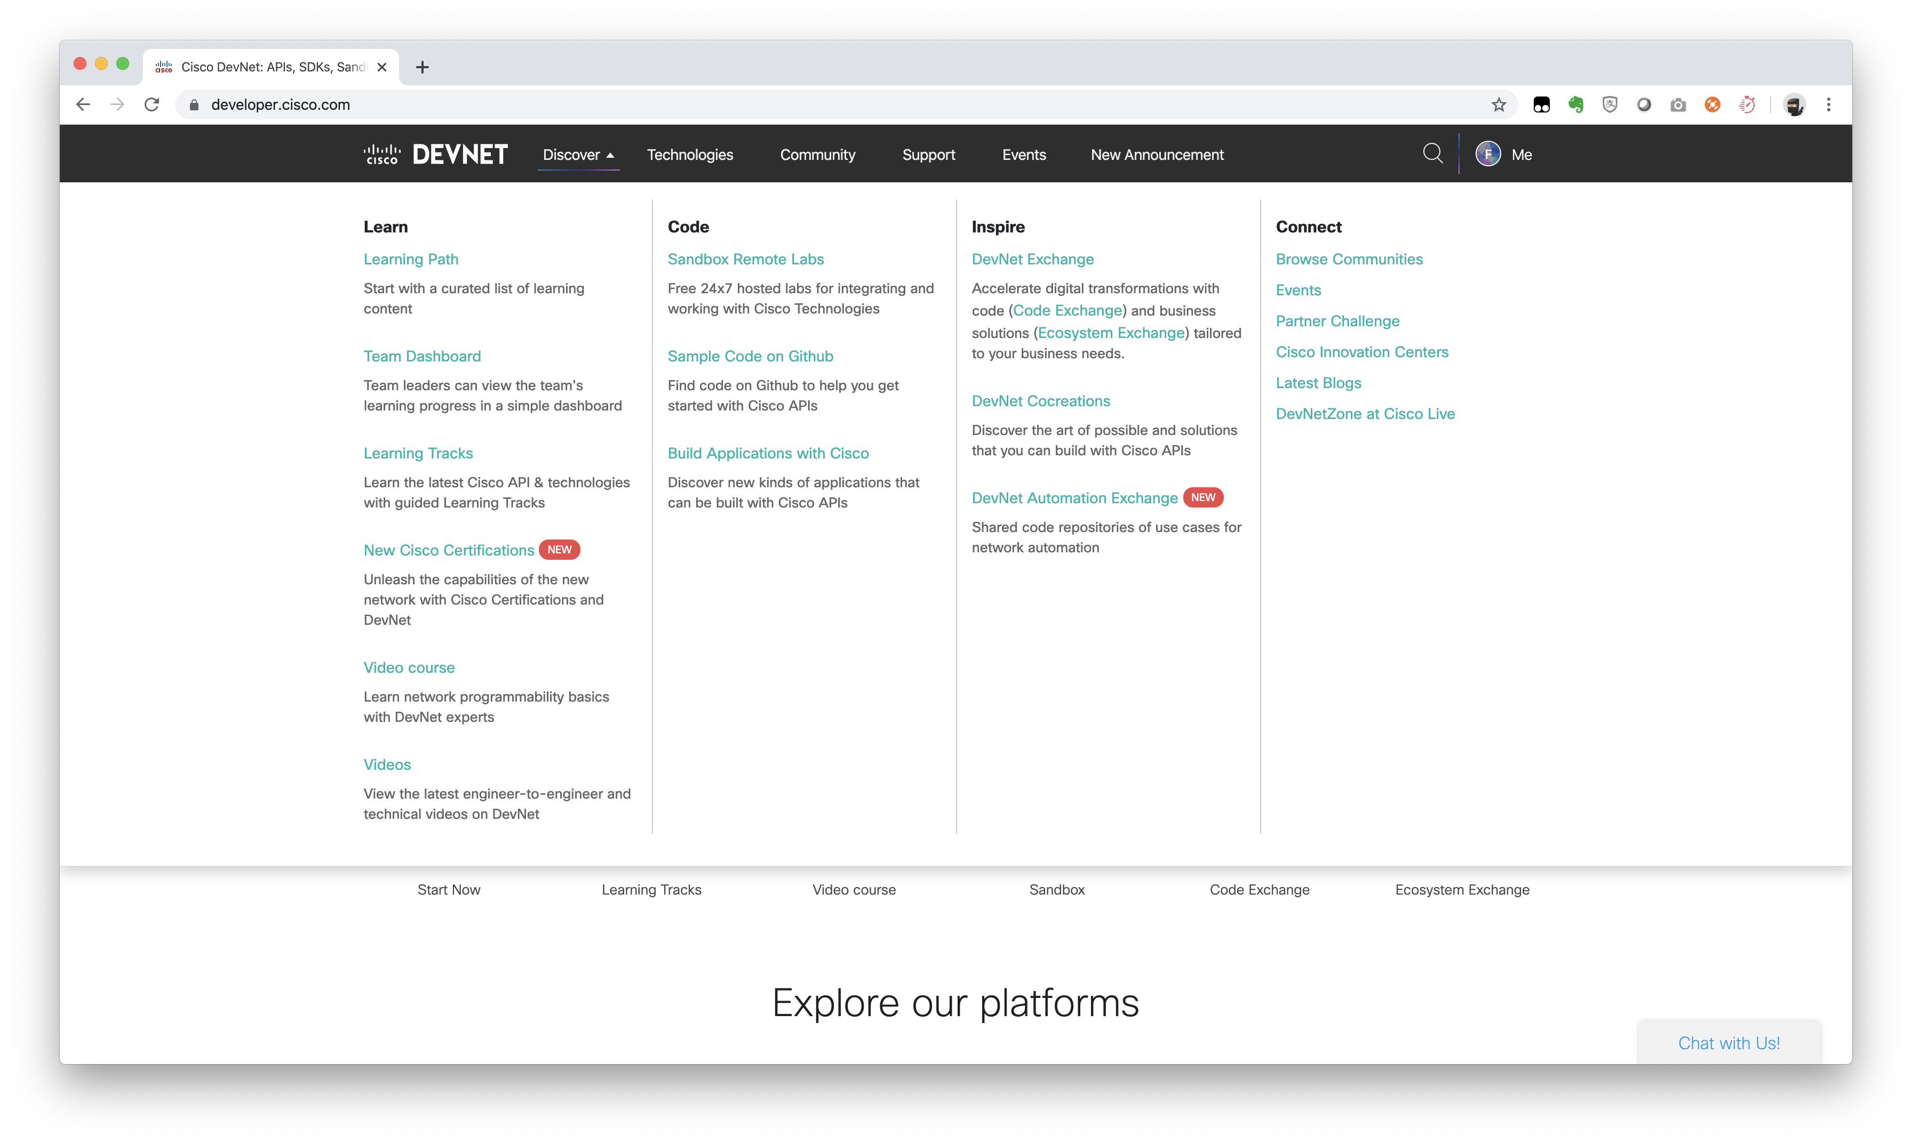

Slide 11
Learning Tracks
Tracks - DevNet Tracks provide you with a guided path to learn selected Cisco technologies.
Modules - Modules are standalone learning units that are used in DevNet Tracks.
Labs - Modules are made up of labs.

Slide 12
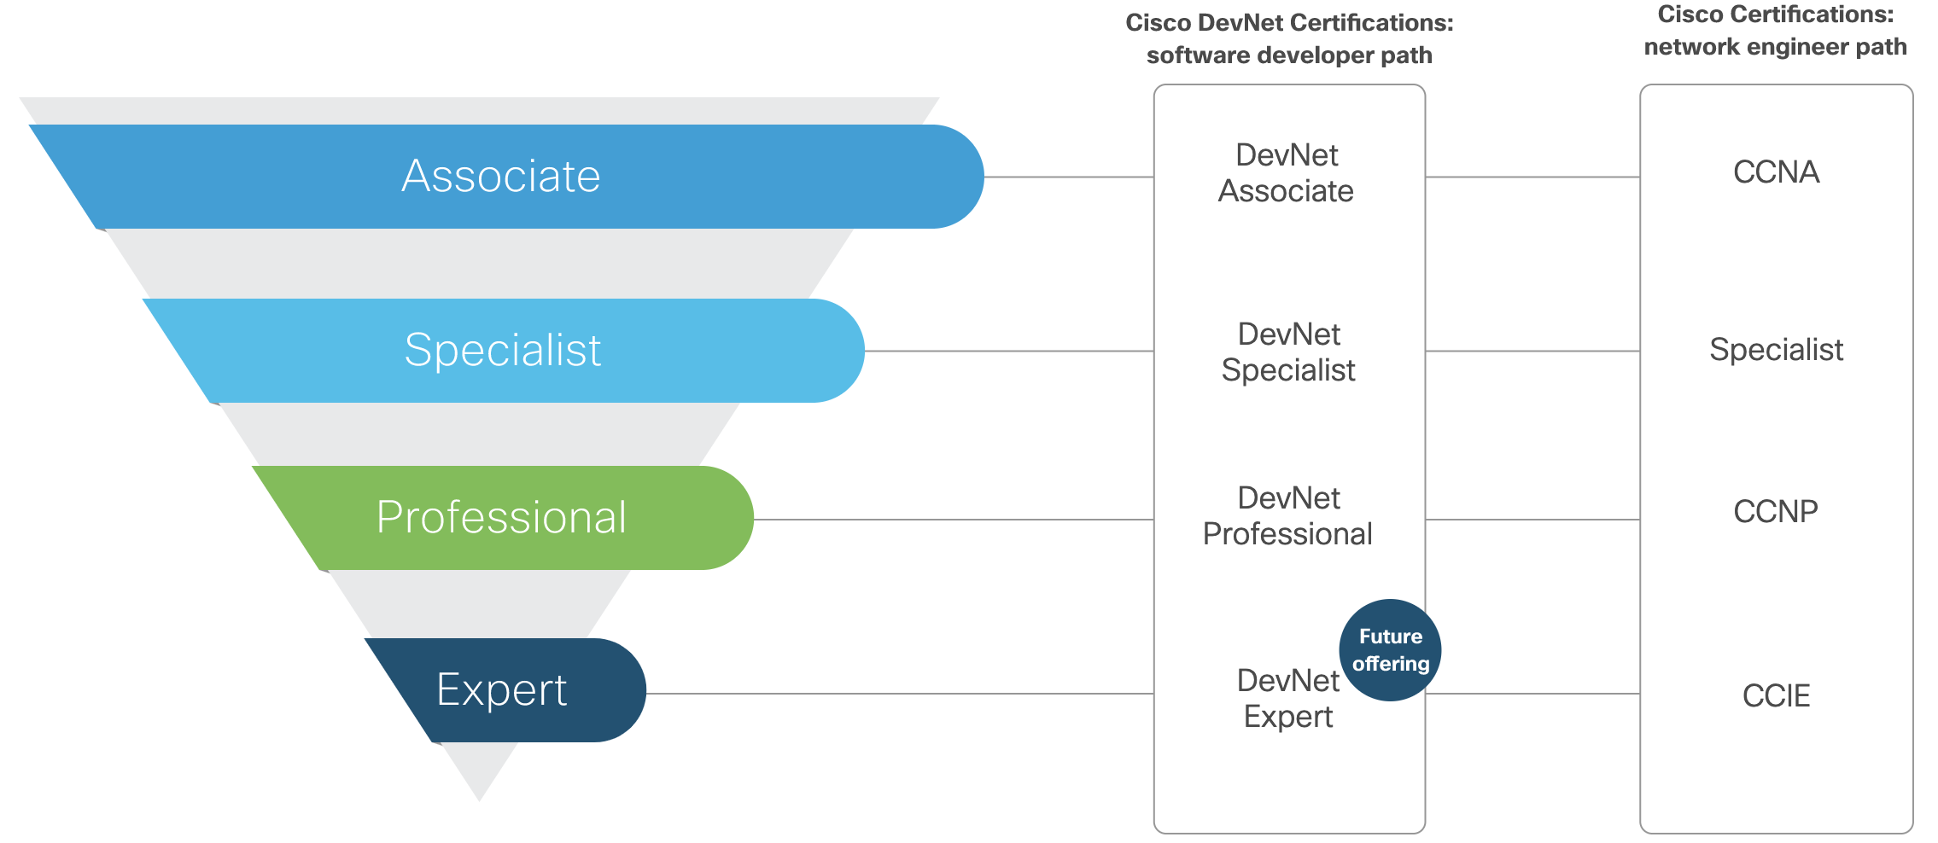
DevNet Certification
DevNet Core exam($400)
+
1*Concentration exam($300)
(ENAUTO, CLAUTO, DCAUTO, SPAUTO, SAUTO, DEVOPS, DEVIOT, DEVWBX)

Slide 13
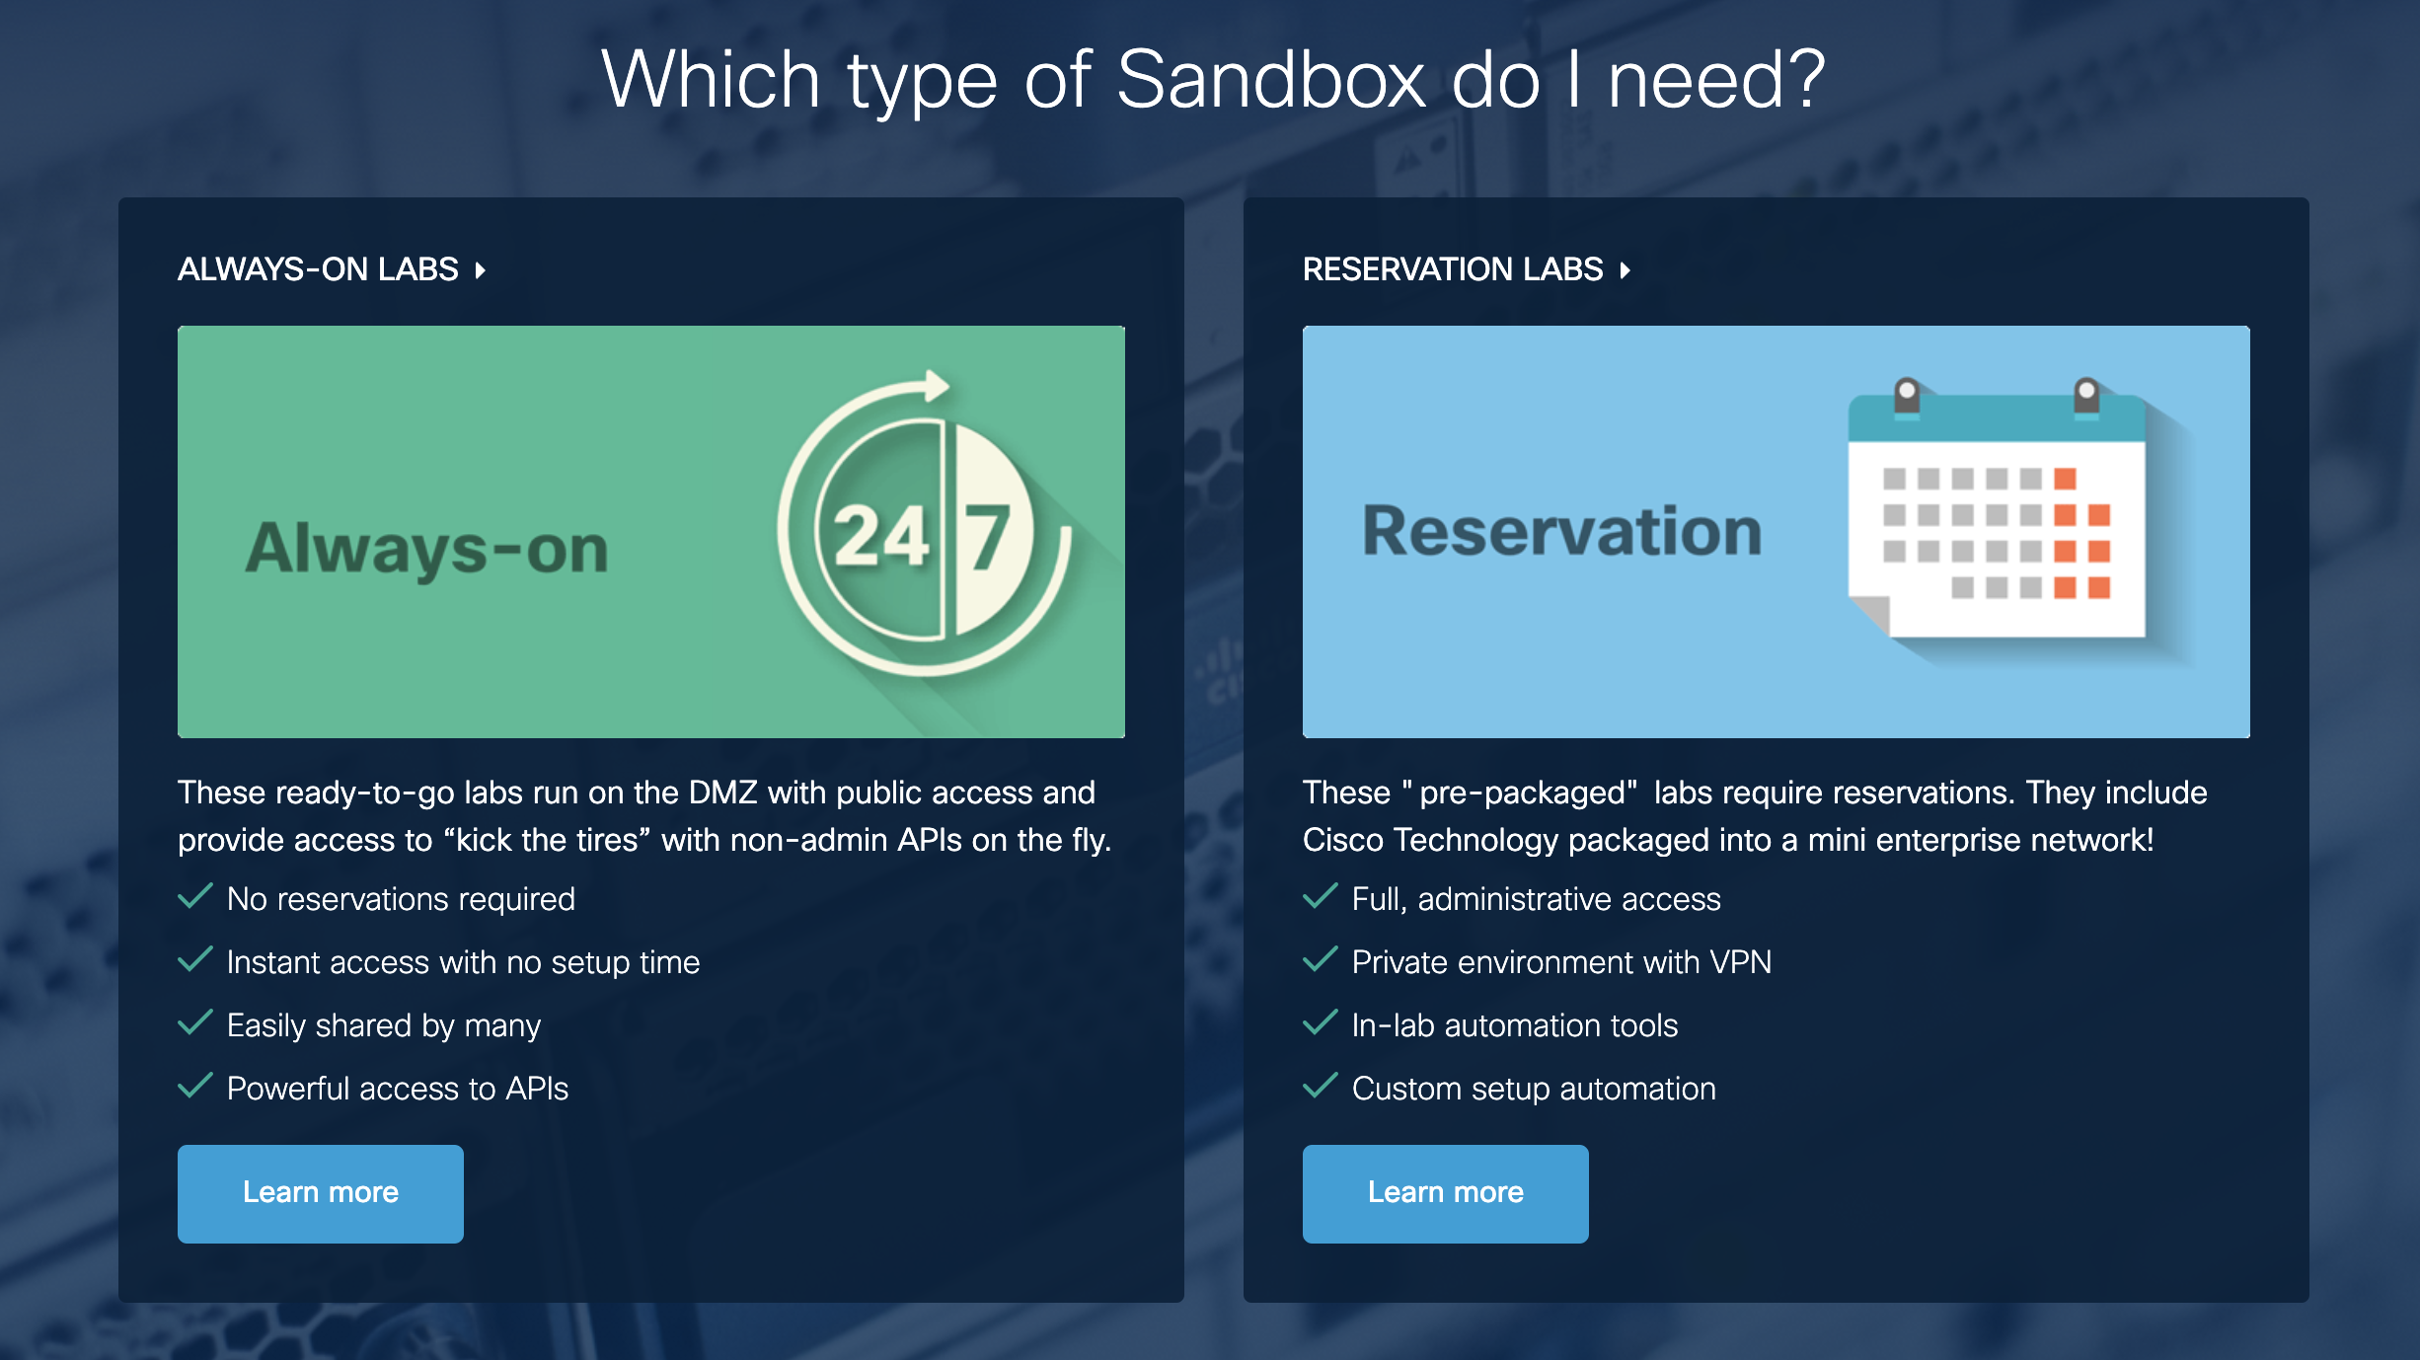

Slide 14
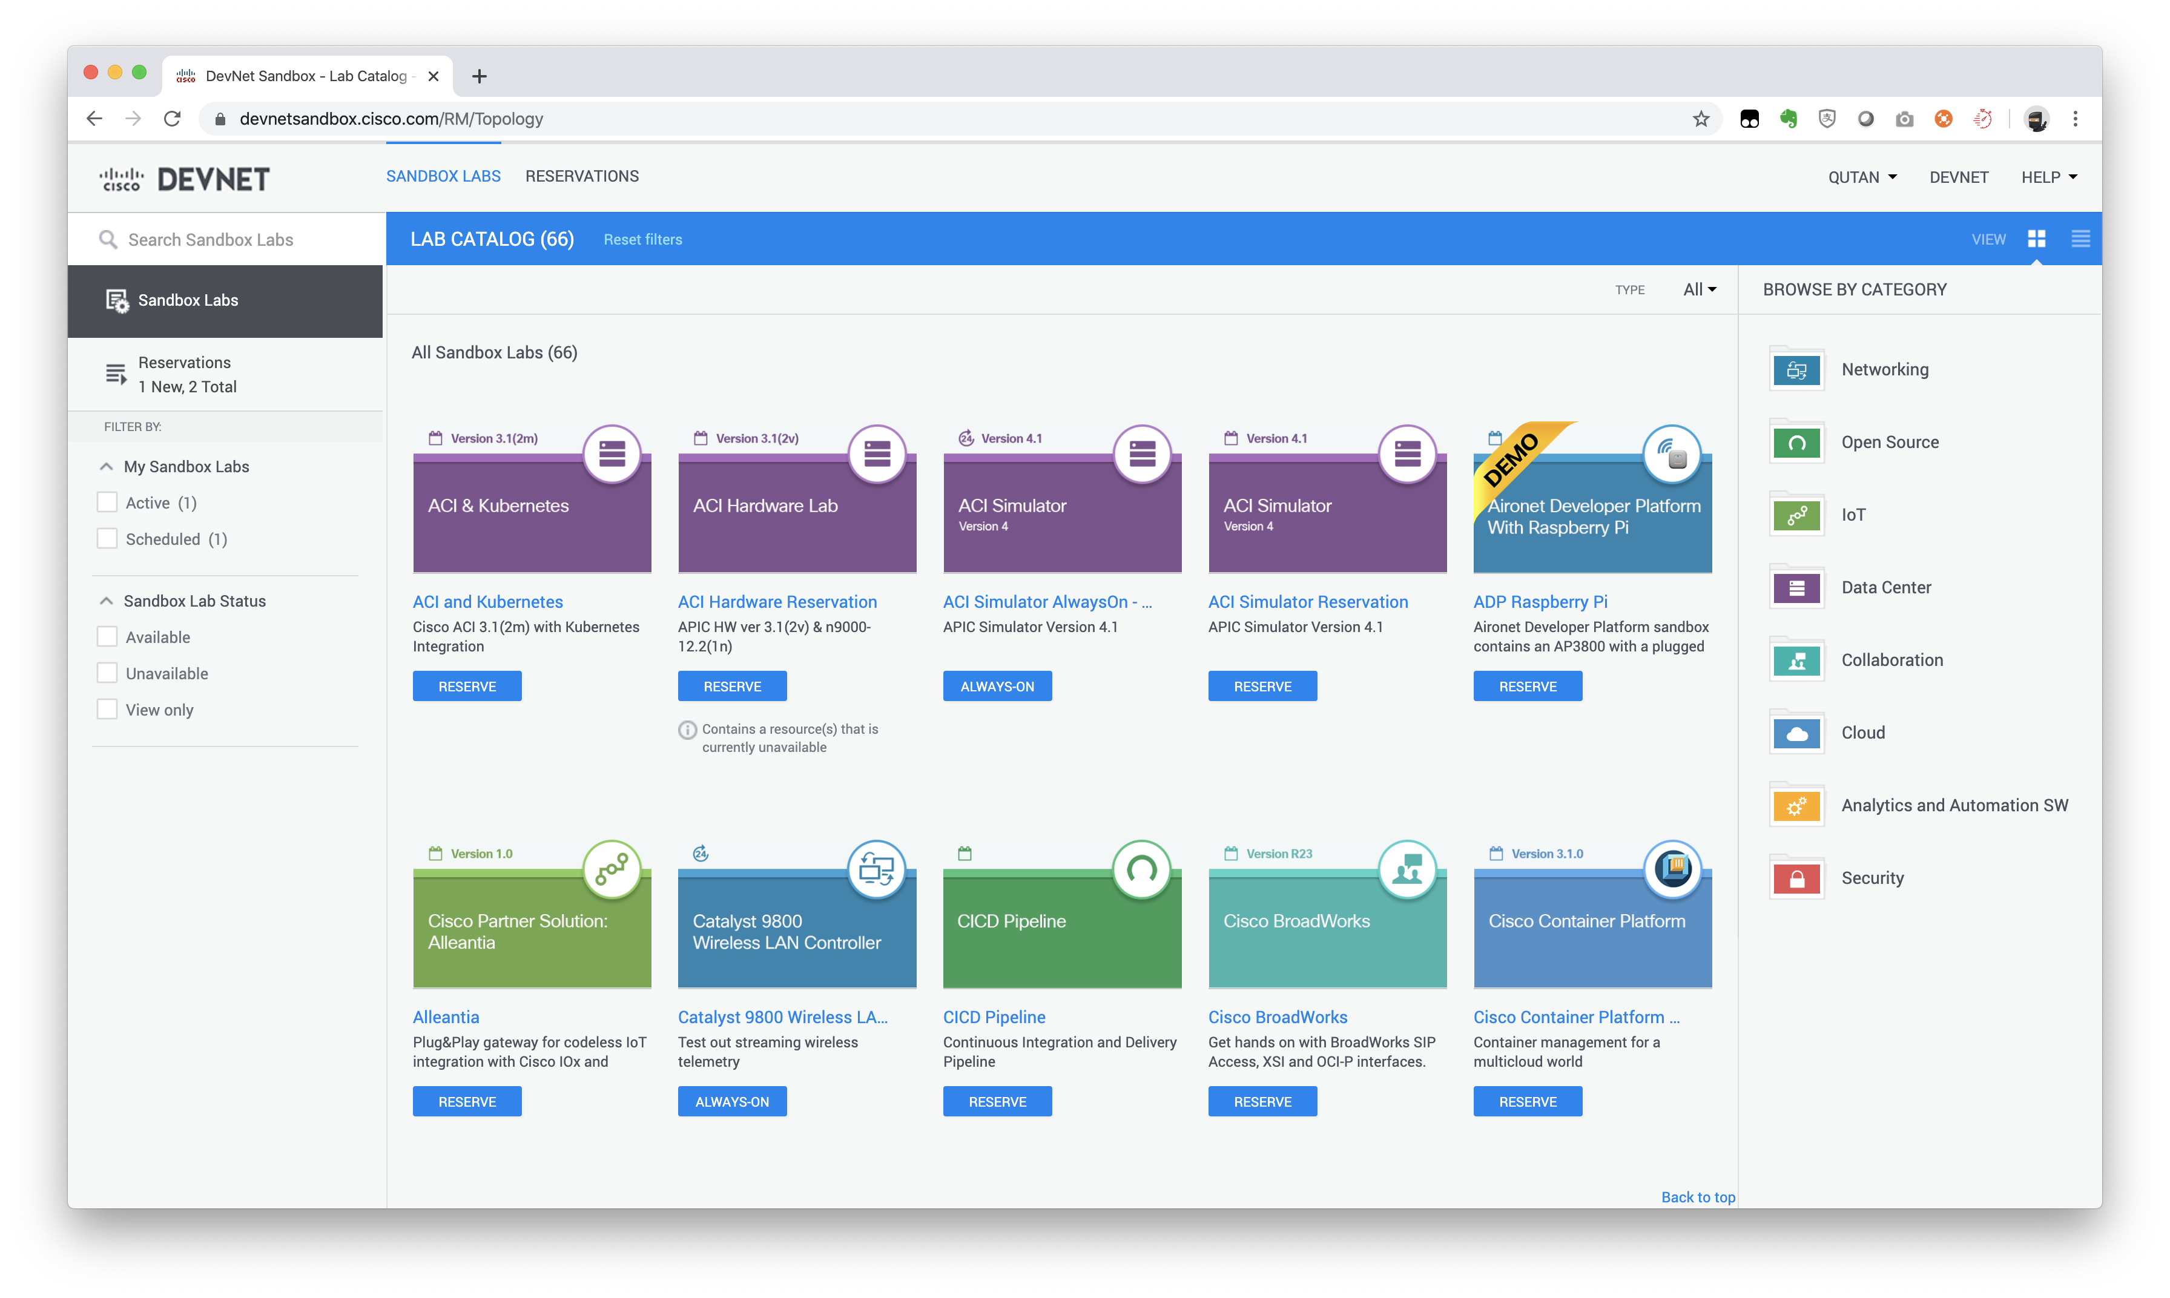

Slide 15
Always-on
Shared Environment with limited functionality.
No admin privileges, no 3rd party applications.
Generally used for learning, endpoint/client connections, or basic REST calls.
No VPN required

Slide 16
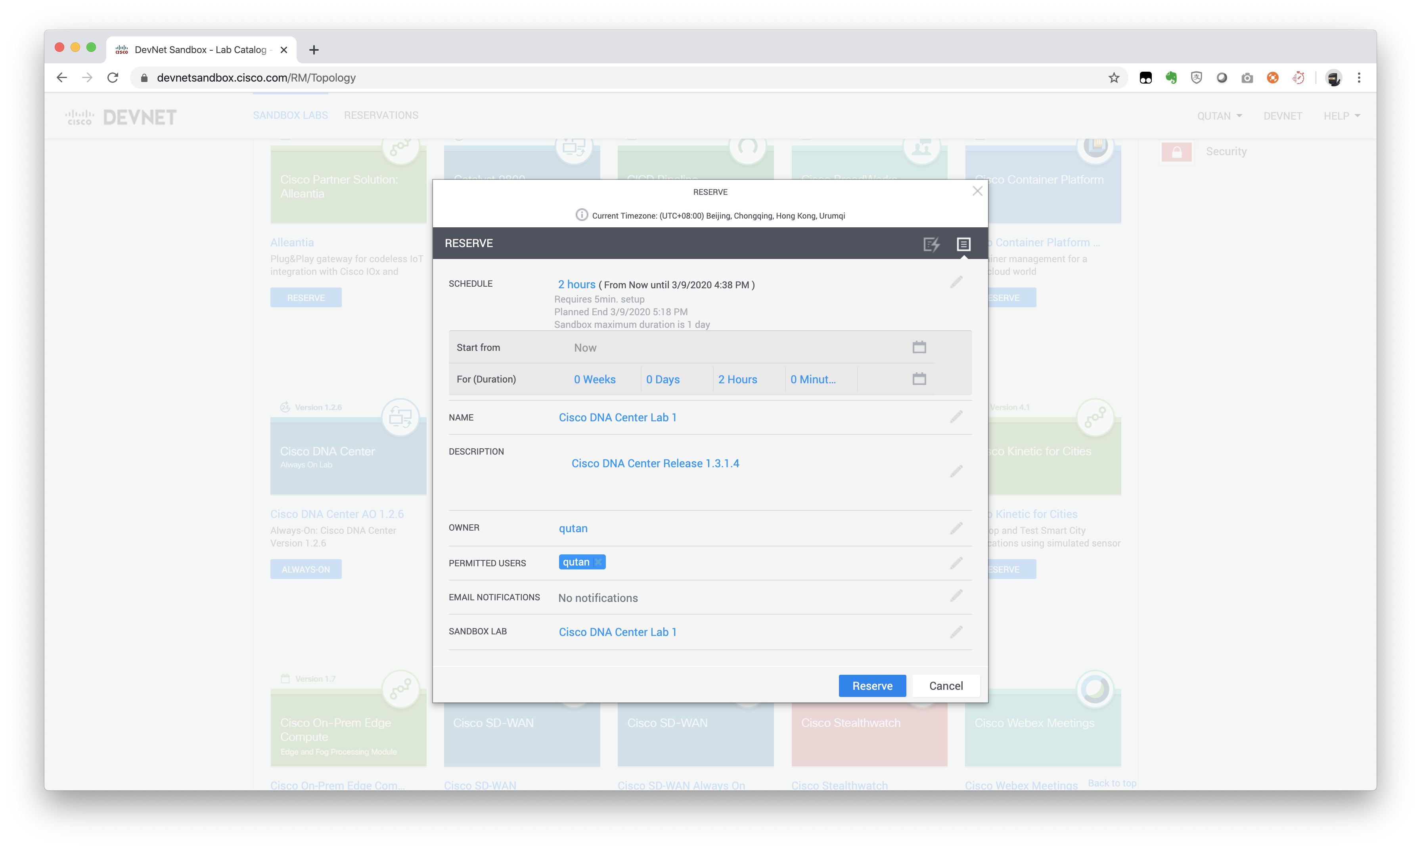
Reservation
Private Environment with full functionality
Hardware or Software VPN access and admin privileges to all/most devices
Generally used for development, testing

Slide 17
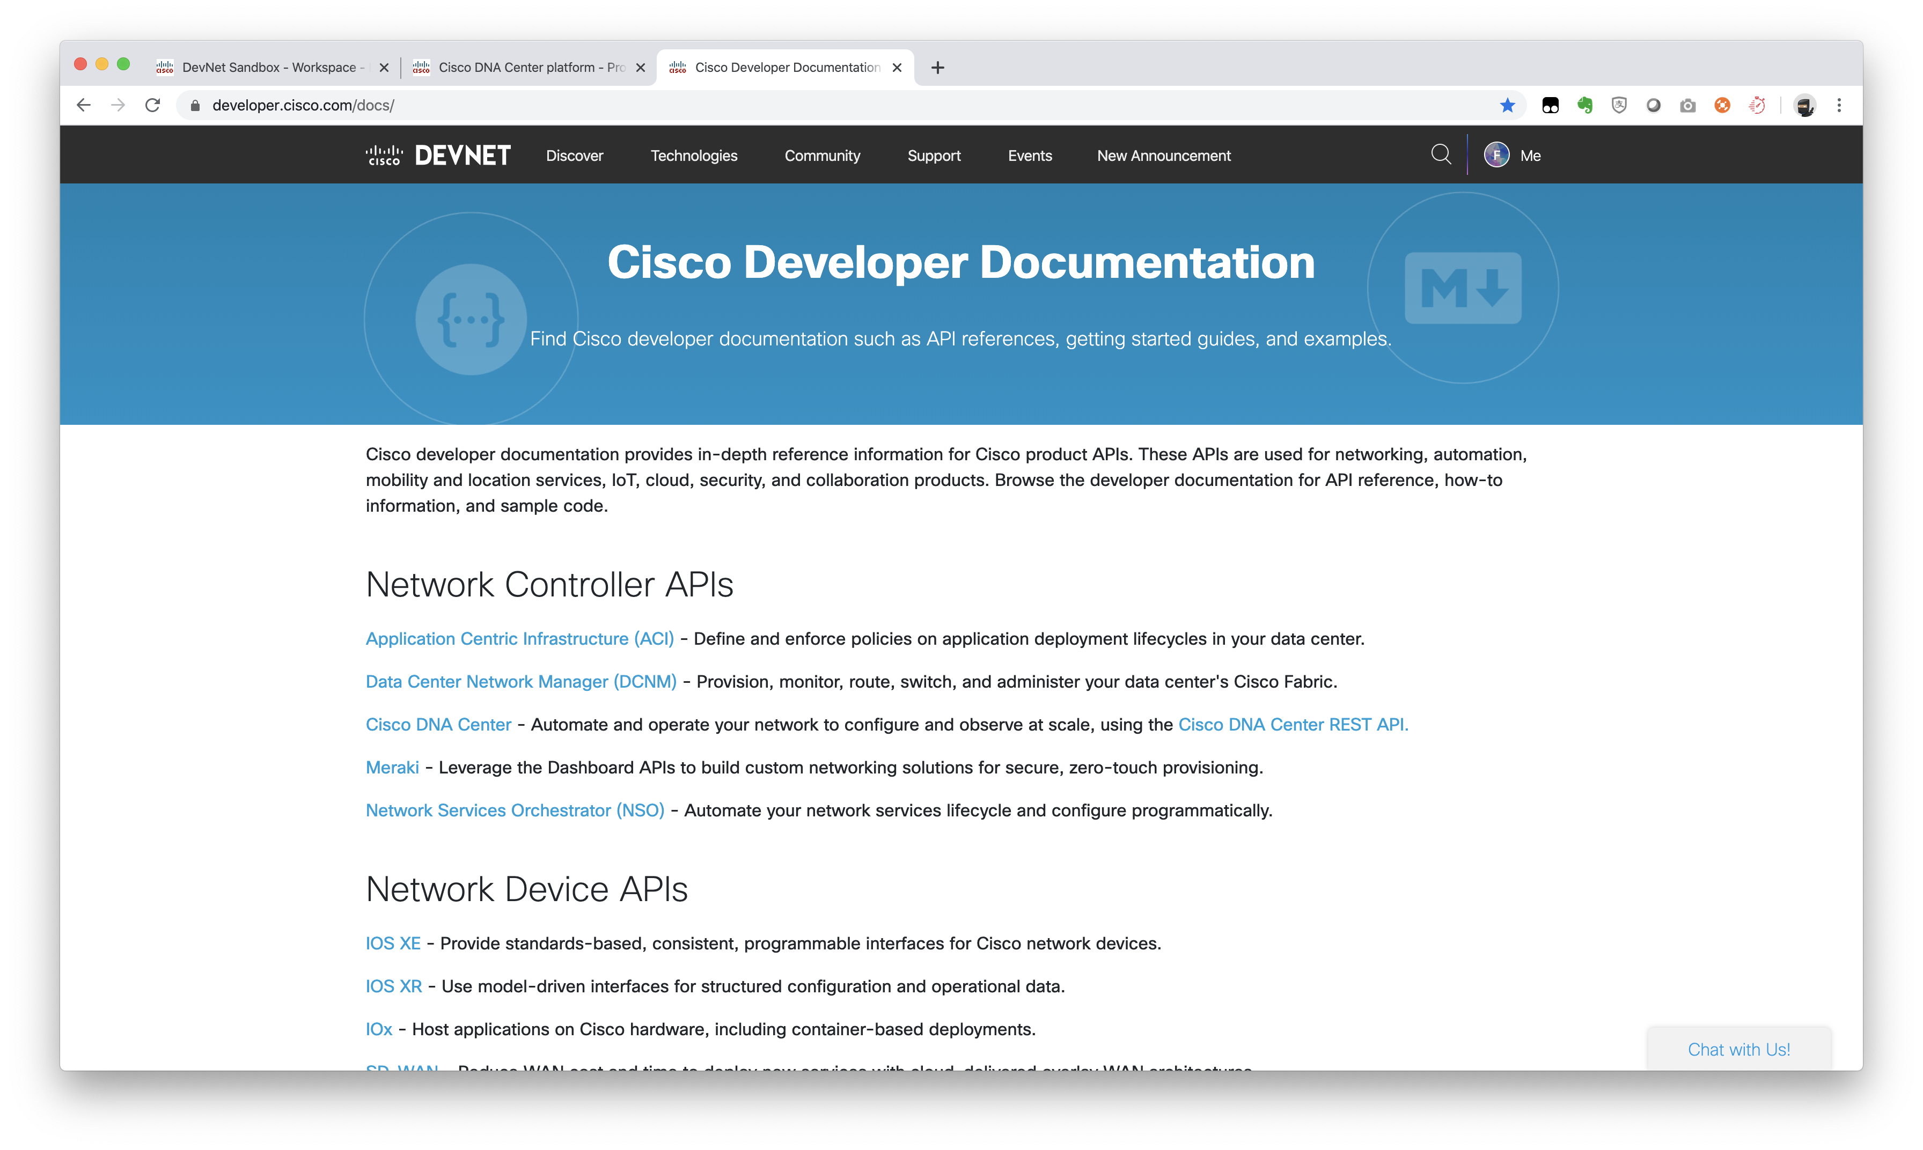
Developer Documentation

Slide 18
Development Environment

Slide 19
The Developer Environment
Local Dev Environment
Hosted Dev Environment
Cloud Dev Environment
Notes:
Definition
These days many people leverage a computer to do their job. This is true for people inside and outside of official "IT" jobs. In the medical field doctors, nurses, and technicians use computers that the medical records and diagnostic software packages installed and configured. Those in financial industries have terminals setup with software for tracking the markets and making trades. And graphic designers and artists heavily leverage image creation and manipulation packages. The collection of software, tools, and specific configurations and setups an individual uses to perform their work can be called their "environment".
A "development environment" is the collection of software, tools, and resources a developer leverages to do their job. Today more and more people are beginning to embrace elements of "development" as part of their job or interests. As programmability and "DevOps" is beginning to become pervasive across information technology roles, infrastructure engineers are finding themselves needing to have access to their own "development environment" where they can explore APIs available in their platforms, create and run scripts and automation programs, and develop software and integrations. Development environments an be local, hosted, or cloud based.
Local Development Environments
The first option for the development environment is to install and configure the development software and tools directly on your local workstation. This provides a high degree of customization and personalization for the developer to choose exactly how they want to work, and because it's all installed locally, it provides a highly portable option.
Hosted Development Environments
In the hosted development environment option, rather than installing the software and tools directly on your local workstation, the developer leverages a virtual machine (shared or dedicated) from a hosting provider where the tools are installed and made available. Developers can then use remote access technologies such as remote desktop or SSH to connect to the hosted environment to do their development.
Cloud Development Environments
A cloud development environment is a type of hosted environment where developers will often access their tools from within a web application.
Next: What do I need in my development environment?

Slide 20
The Operating System
Notes:
As we are talking about running software on a computer, we must start with an operating system. The good news is that the latest versions of Windows, Linux and Mac OS all can be the foundation of a very useable and productive development environment.

Slide 21
Source Control System
Notes:
If you are building a development environment, it is safe to say that you'll be working with "code" of some format. And whether that code is for web applications, mobile applications, scripts, or anything else, you'll be needing a place to store, track, and often share the code. And while you could store your code in a local or shared folder, a cloud drive, or flash drive managing versions manually with new folders and names like code_v12.py, one of the first development tools you should become comfortable with is a source control (or version control) platform.
Source control systems like git or Subversion are a core part of the software development workflow. These systems provide robust document management capabilities allowing software developers to easily work with code saving revisions (commits), exploring potential possibilities in isolated environments (branches), and combining work from multiple developers or work streams (merges).

Slide 22
Terminals and Shells
The command line user interface
Examples of shells include:
bash (or "Bourne-again shell")
cmd.exe
PowerShell
Notes:
While many graphically interfaces and applications are available for developers today that aim to increase developer productivity by providing an easy to use and powerful platform for developing code, as a developer you will need a command line terminal to run code, and interact with services and systems. Also, in many cases the most productive tools for a developer are built as command line tools.
The "shell" is the command line user interface for interacting with a computer. Shells have been around for the entire modern computing age, and there are many different options available across operating systems.
Examples of shells include:
bash (or "Bourne-again shell") is a common shell for Unix and Linux based operating systems
cmd.exe is the native command line interpreter for Windows systems.
PowerShell is a combination shell and scripting framework from Microsoft that has recently become open source and cross platform

Slide 23
Programming Languages
Notes:
Programming languages provide the words, syntax, and rules that developers use to build applications. The "code" that is written, is written in a programming language. Over the years there have been countless (well not countless but it sounds better than "numerous") programming languages created. Typically an individual language is designed for a specific type of application or use, which means that it is unlikely there will ever be only "one programming language to rule them all."
Depending on the language you plan to write your code in, you may need to install different components on your development workstation. Some examples include:
Compiler: A software compiler translates the code written in a programming language to a target language (format) that can be executed by a computer. The output of a compiler is often referred to as "machine code" or "assembly", the low level instructions optimized for execution by processors. Once compiled, users of an application do not require the compiler on their system. C++ and Go are two examples of languages that require a compiler.
Interpreter: Some computer languages are not designed to be compiled, but rather are processed directly by another program that can "interpret" the instructions and perform the action. With interpreted languages, both the developer and users of the application require the interpreter to be installed. Python is an interpreted language
Software Development Kit (SDK): SDKs are packages of software development tools installed by developers to provide them the utilities and resources necessary to create applications in a programming language, for a particular environment, or hardware platform. SDKs are only needed by the developer to create the application, users of an application would only need the final output. Java developers leverage the Java SDK to develop applications.

Slide 24

Text Editors and IDEs
atom
PyCharm
Notes:
An application's "code" is typically a collection of text files, and the act of "coding" involves writing and editing those text files. This means one of the most used of the software developers tools is the program they use to work with these text files, generically called a "text editor". The features that make a good developers text editor are very different from those that make a good word processing applications used to write papers and publication documents.
The "code" of an application will be either compiled or interpreted by another software application that will process the raw characters as presented in the file. This means that code must be clear of hidden formatting characters and leverage expected punctuation characters as designed by language rules. Many programs used to write documents for human consumption actually use file formats like "Rich Text Format" (RTF) that manipulate the entered text by changing the entered characters to a more "visually pleasing options" (eg: changing the basic '' or --) and embed hidden formatting instructions within the file. This makes the first rule of a good developers editor that it work in "raw text"
While making the code "look nice" is irrelevant to the function of the code, it can be helpful for a developer as they work to have key words in code colored differently, syntax errors highlighted, and common programming elements suggested or auto-completed while working. Developer friendly text editors often have language processors and styling built into them so that when it detects (or is told) that the file being worked on is of a particular type it can implement these types of features.
Sometimes a developers editor includes features beyond just text editing. Perhaps it also integrates with the source control system to make checking in code easier. Or maybe it includes a shell interface directly within the application. As text editors begin to extend like this, they enter into a new category of developer tool called an "Integrated Development Environment" or IDE. IDEs are robust applications that attempt to provide the developer with everything they need to do their job within a single application.

Slide 25


Development Tools and Clients
postman
Notes:
A developer's job is more than just writing code. They also need to explore the different APIs that they consume within their code. They need to test their own application as they write it. And as many applications are written today for consumption through a web browser, they need tools to verify and troubleshoot web applications. There are countless (well, you could probably count them, but it would be really hard) options for developers to use to solve these needs, and often the ones used will change as the developer is faced with a new project or problem.

Slide 26
Application Container Engine
Dependency packaging
Efficient packaging
Isolated runtime
Host platform
Notes:
Developers have always faced the challenge of how to package up and provide their application to the users that will need to or want to use it. Many methods and options have been developed and used over the years, and today a very common mechanism in use is to deliver applications in "containers."
Simply put, an application container is a packaging method where the application code and any dependencies are combined together in an efficient format that can be easily run in isolated from other "containers" on a host platform. Let's breakdown the key elements of the definition.
Dependencies: Developers rarely write every bit of code that makes up their application. More often they leverage code or even other applications written by other developers. Examples of this include something as simple as "importing" a module or library into code to simplify a complex task like time/date manipulation to a web developers need for a web server to host their web application. Everything an application needs outside of the code the developer directly writes is a "dependency".
Efficient: Virtual machines have long been used by companies to run applications in a more efficient method than having independent physical servers for every application. The move to VMs was a step for efficiency, but a VM includes far more than most applications need to run. Containers provide a significant improvement in efficiencies for running applications in the areas of CPU, memory and storage space.
Isolated: When running, each application should be contained within it's own execution space and not have access to, or be impacted by, other applications running. The reasons for this include security concerns as well as application stability and conflict isolation.
Host Platform: Like virtual machines, containers must be executed on some host platform. A single host platform should be able to run many containers simultaneously, each in their isolated environment.

Slide 27
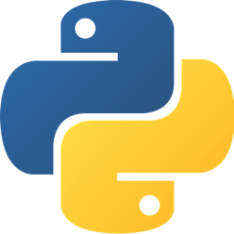
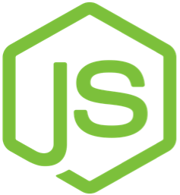

What are some good tool choices to start with?
Source Control System
Terminal / Shell
Programming Language
Text Editor / IDE
Dev Tools and Clients
Container Engine
Notes:
With the basic types of tools and considerations to make for your development environment, here are some suggestions on tools to look at as you begin your development journey. It is important to remember that this list is not intended to say these are the tools you should use, but rather provide a basic starting point for engineers looking for one. The tools chosen in this list represent options that are common, simple, and available as open source or free options. If you have already begun working with a tool that meets your needs successfully, that is great and please continue to use it.
Remember the great software development advice from Aristotle "The best text editor is the one you know how to use".
The later labs in this module will provide a walkthrough on how to install and test the following toolset on Windows, Mac OS, and Linux.
Operating System
Thankfully today you can be successful no matter which of the three common operating systems today. Not that long ago it was the case that it was good advice to pick the operating system for development that matched the operating system you were developing for, but with the advanced in tooling and capabilities of operating systems developers have much more freedom.
The one caveat to that statement is that it is highly suggested to be on the latest versions of the operating system, particularly for Windows users. While Windows 10 provides a solid foundation of capabilities that you'll need as a software developer, you will be more challenged if you are on an older version of Windows.
Source Control Systems
git
While there are several popular source control systems available, if you are just getting started git is a great choice to begin. Partially due to the popularity of GitHub, git has become one of the most commonly used source control systems in the development world today. And by installing and becoming familiar with git, you'll be able to quickly participate in the large and growing community of developers.
Furthermore, all of the sample code and resources available from Cisco DevNet are hosted in git repo's and you'll need it installed to easily consume those resources.
Terminals and Shells
bash
While bash is the default interpreter for Unix/Linux/Mac OS operating systems, it is also available today in several forms on Windows operating systems today.
By installing and leveraging bash on Windows, it will be much easier for developers using a Windows based environment to replicate and leverage code samples, tutorials and lessons found online. In the following lab on installing and setting up a Windows environment, you will be shown how to leverage the git-bash shell that is included with git for Windows.
Programming Languages
The programming language you install and setup the developer tools will depend explicitly on which languages you plan to write your applications in.
Python
Python is an interpreted programming language that has become quite popular due to it's simple to learn, yet very powerful syntax and feature set. Particularly for infrastructure engineers, Python has become the de-facto language of choice.
Node.js
Node.js is a JavaScript runtime that is very popular for developers because of the JavaScript foundation providing a consistent language across web (sometimes called "frontend") and application (sometimes called "backend") development.
Text Editors and IDE
Few aspects of the development environment tooling choices will be as potentially opinionated or personal as the text editor or IDE chosen. And as you do more development and coding, you'll likely test out and use a variety of options at any point in time. That said, if you have a preferred choice already, feel free to continue leveraging it.
Atom
If you are just getting started with coding and are looking for a suggestion on something to use, or if you are "in the market" for a new text editor, a great option to check out is Atom. Atom is an open source text editor available for Linux, Mac OS, and Windows that also provides many powerful features and plugins that you can explore as you become more comfortable coding and are interested in adding more "power" to your workflow.
Development Tools and Clients
Like the choice of programming language will depend heavily on the type of coding you plan to do, the types of tools and clients you'll need will also vary. Here will introduce and suggest a few that are handy to have, or at least be aware of, as you start your programming journey.
Postman
Postman is a powerful REST API client that provides a set of capabilities for testing, exploring, and writing REST APIs. Postman offers both free and paid options, with the free solution offering a set of features useful for most beginning developers.
ngrok
Many times the applications and scripts that you write as a developer maybe intended to be deployed to the public internet and made available for external users to access via a web interface, or REST API. For example, if you are writing a chat bot, your bot will need to be reachable by the chat service which is often "cloud based." During the development phase, you'll want to run the code locally within your development environment to test that it is working before deploying to a production system. To be effective, you need a way to expose the code running on your workstation to public internet services, and putting your development environment directly on the Internet is often not possible or practical.
ngrok is one of several possible tools that aims to solve this problem for developers. It is an application you'll run on your environment, and it builds a connection path from the public internet to your local workstation. Because it is initiated from your workstation, it works well through firewalls, proxies, and NAT services.
Google Chrome
You likely already have a preferred web browser, or maybe you use multiple browsers, to access the web and browse sites. As you begin to use the web as a "developer", you'll find yourself using browsers in ways other than typical research or social media. You may want to test compatibility of your application across browsers and form factors, explore the HTTP calls that are being generated by your browser, or debug the JavaScript that is running within the web client. Google Chrome provides a robust set of "Developer Tools" the peel back the curtain on the the HTTP process.
AnyConnect or OpenConnect
While not strictly a developer tool, a VPN client will be helpful to install in your environment if you plan to work with some of the DevNet Sandboxes for access to different hardware and software platforms for testing and coding against.
Cisco AnyConnect is a popular VPN client for many enterprises, and if you already have it installed, you can use it to connect to the DevNet Sandboxes.
If you do NOT have AnyConnect, the open source alternative OpenConnect can also be used.
Application Container Engine
Docker
Docker is not the only application container engine, and wasn't even the first. But it is definitely the most popular one in use today, and unless your organization or specific use case requires another option such as native Linux Containers (LXC) it is the one you should start with.

Slide 28
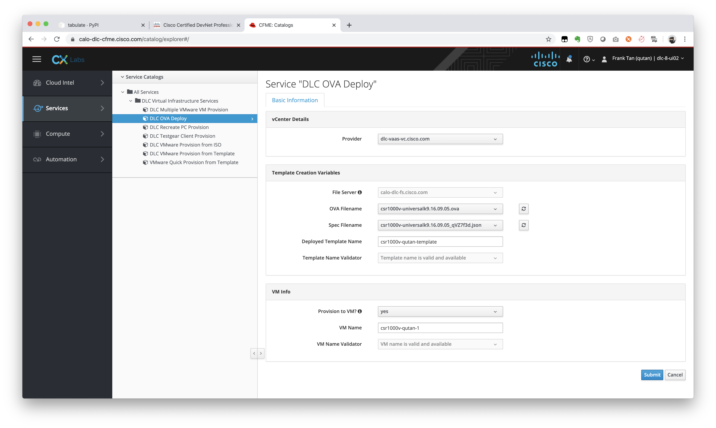
Last but not least..
https://calo-docs.cisco.com/doku.php?id=external:cloudforms:ova_automation&s[]=ova

Slide 29
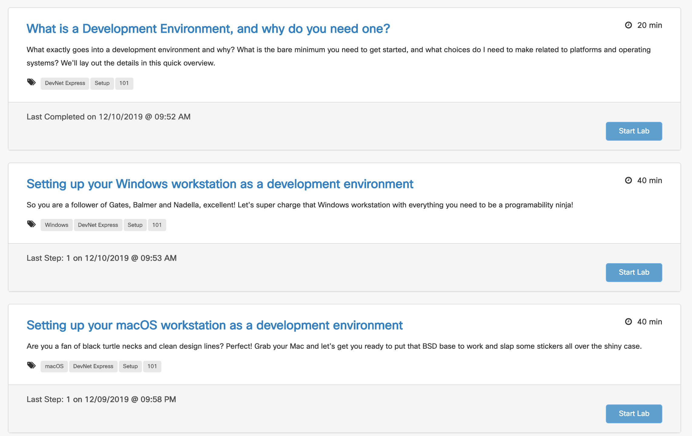
Hands-on
Developer Workstation and Environment Setup (Step-by-Step Guide)
https://developer.cisco.com/learning/modules/dev-setup

Slide 30
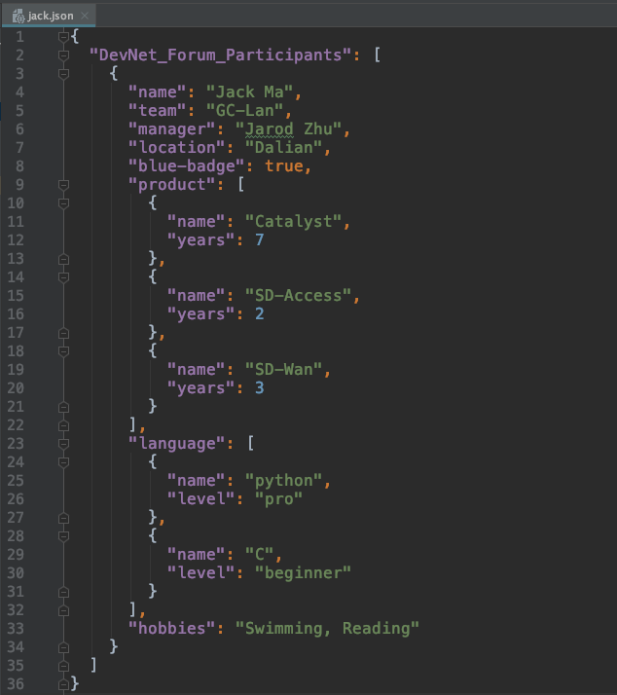
Self-intro in JSON

Slide 31
Who’s Next?
Copy json file to your computer
Modify with your own data
Upload it to github
Check it out soon!
https://github.com/tqs0117/devnet_forum/blob/gc_ent_ss/1.dev_env_setup/demo/jack.json
$ git clone https://github.com/tqs0117/devnet_forum.git

Slide 32
Continue to study..
Learn network programmability basics (DevNet Video Courses)
https://developer.cisco.com/video/net-prog-basics/
Python Tutorial
https://www.learnpython.org/
Cisco Digital Learning Library (CDLL)
https://cxtraining.cisco.com/c/cdll_infbundle/

